Slide 1

Principles for preparing presentation slides
Prepared by
Motaz Saad
Fall 2019

Slide 2
10/20/30 rule
10 slides
20 minutes
30 point font
Source : http://guykawasaki.com/the_102030_rule/

Slide 3
Ideas from cognitive science
Give the right amount of information
Make data stand out from the rest
4 items maximum per slide (avoid overload)
Using grouping (color, size, … ) to associate data or ideas

Slide 4
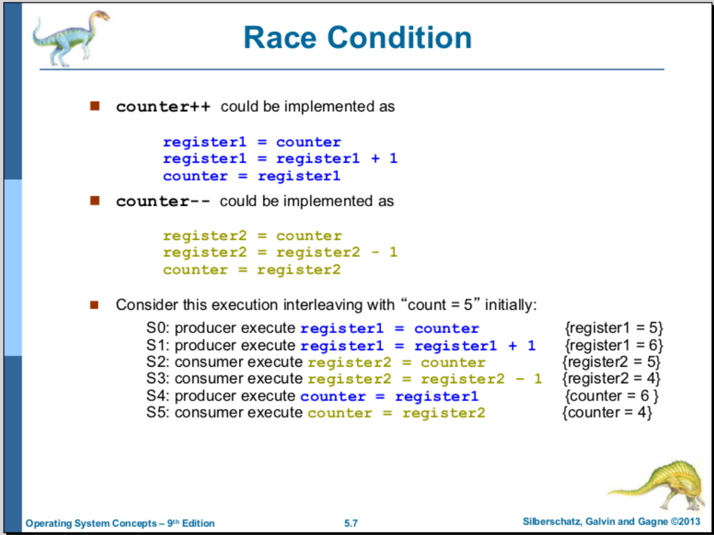
Example of use coloring and grouping

Slide 5
Text rules
Avoid paragraphs
Use appropriate fonts
Avoid dense data
No capitalization of ordinary text
Distribute a handout
No sound effects
No transition effects
No cheesy images

Slide 6
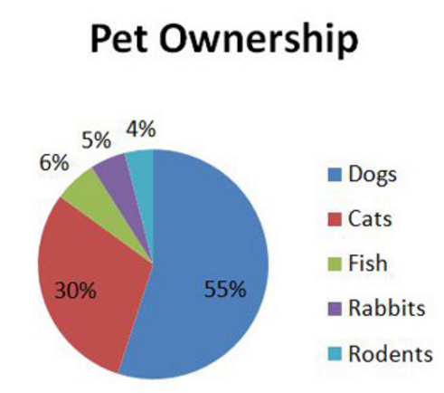
Graphics rules
Use highly quality graphics
Display graphical data (pie chart, bar chart, …)
Use colors well

Slide 7
Delivery
Voice
Eye contact
Posture
Gesture

Slide 8
Deliver information
Use your voice intonation to deliver information. For instance, if you want to motivate the audience and ask them a question, use question intonation in your voice. Constant intonation makes the audience sleepy 🙂
Use eye contact to deliver information to the audience and to get feedback from them. Watch the condition of the audience, are they sleepy? focused? understand what you present? …
Posture: Your posture presents your personality and confidence.
Use gesture, hands, to deliver the point.
Point out to points, figures on the slide. For instance, “the figure the left side of the slide presents …”.
Do not turn your back to the audience to read from the slides. This gives an indication that you are not prepared and it is very boring. If you are like so, then it is better that the audience read the slides and no need for you!
Dress as usual (normal dress), you come to present your ideas not to present your dress 🙂

Slide 9
Answering questions
Control the audience
Repeat the question before answering
Answer briefly

Slide 10
End of slide

